Slide 1

307307 Introduction to Text Mining and Natural Language Processing

Slide 2
What is Natural Language Processing?
Natural Language Processing (NLP) is a field at the intersection of computer science, artificial intelligence, and linguistics focused on enabling computers to understand, interpret, and generate human language.
It forms the foundation for all language technologies we use today, from search engines to voice assistants and modern large language models.
A peek into the history of Language AI – Hands on LLMs, Jay Al Ammar Book

Slide 3
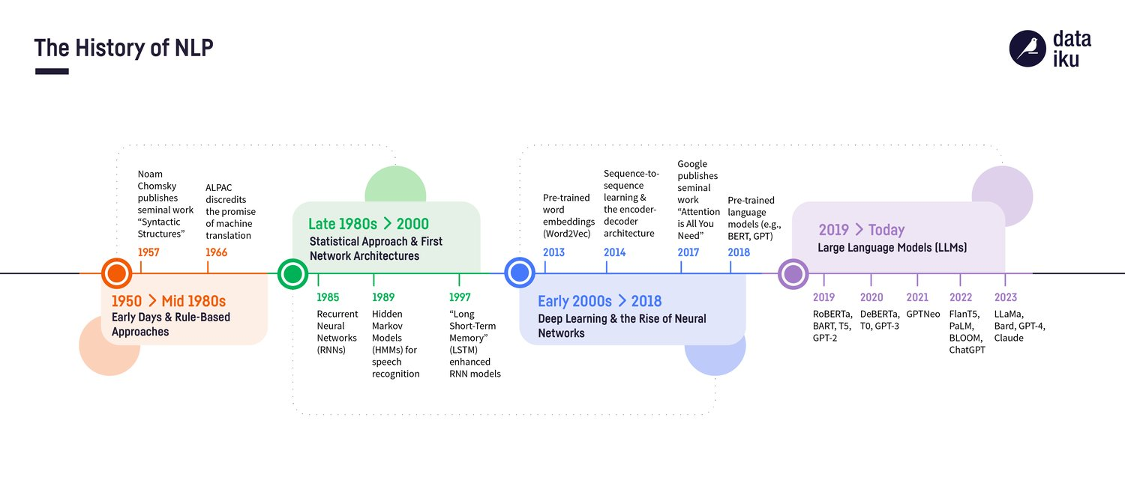
Historical Development of NLP
NLP has evolved dramatically over the decades:
1950s-1960s: Rule-Based Approaches
Focus on machine translation during the Cold War
Primitive rule-based systems with hand-crafted grammars
Limited by the complexity of language rules
1970s-1980s: Statistical Revolution Begins
Introduction of probabilistic models
Hidden Markov Models for part-of-speech tagging
Still limited by computational power and data availability
1990s-2000s: Statistical NLP Flourishes
Large text corpora become available
Machine learning approaches gain prominence
Statistical machine translation emerges
2010-2018: Neural Revolution
Word embeddings (Word2Vec, GloVe) transform representation
Recurrent Neural Networks and LSTMs for sequence modeling
Attention mechanisms improve performance
2018-Present: Transformer Era
BERT, GPT, and other transformer models revolutionize the field
Pre-training and fine-tuning paradigm
Increasingly human-like language understanding capabilities

Slide 4
Why is NLP Challenging?
Human language is ambiguous: Words and sentences can have multiple interpretations
Lexical ambiguity: When a word has multiple meanings
Example: "The bank is closed" (financial institution or riverbank)
Example: "The suit was expensive" (Formal set of clothes or Legal proceeding)
Computational challenge: Systems must select the correct word sense from multiple possibilities
Syntactic ambiguity: When a sentence can be parsed in multiple ways
Example: "I saw the man with the telescope" (Who has the telescope?)
Example: "Flying planes can be dangerous" (The act of flying planes or planes that are flying?)
Computational challenge: Models must determine the correct grammatical structure
Semantic ambiguity: When the meaning of a sentence has multiple interpretations
Example: "The chicken is ready to eat" (Ready to be eaten or ready to consume food?)
Example: "John and Mary got married last year" (To each other or to other people?)
Computational challenge: Systems must infer the intended meaning based on context
Pragmatic ambiguity: When the intended meaning depends on context, intent, or implied information
Example: "It's cold in here" (Statement of fact or request to close a window/turn up heat?)
Example: "Do you know what time it is?" (Yes/no question or request for the time?)
Computational challenge: Models must understand communicative intent beyond literal meaning

Slide 5
Common NLP Applications
1. Sentiment analysis: Determining the emotional tone of text
Identifying if customer reviews are positive, negative, or neutral
Tracking public opinion on products, services, or topics
2. Machine translation: Translating text between languages
Converting text from one language to another while preserving meaning
Handling cultural and linguistic differences across languages
3. Text generation: Creating human-like text
Automatic summarization of longer documents
Creative writing assistance and content creation
Dialogue systems for conversational AI
4. Question answering: Providing answers to natural language questions
Extracting answers from documents or knowledge bases
Understanding user intent and providing relevant information
5. Information extraction: Identifying and extracting structured information from text
Pulling key data points from unstructured documents
Converting text documents into structured databases
6. Text classification: Categorizing text into predefined categories
Sorting emails into spam/not spam
Organizing documents by topic or content type

Slide 6
Text Processing Pipeline

Slide 7
Text Mining Pipeline
In this chapter, we will discuss the common methods that we can use to mine information from text. We will learn about text-processing techniques that can assist us in converting text into numerical representation that is suitable for mining information.
We will discuss the techniques and the pipeline shown below:
Sentence Tokenization
Text Normalization
Stopwords Removal
Stemming and Lemmatization
Representing text using the Bag of Words method
Implementing a predictive model based on text representations
Tokenization
Normalization
Stopwords
Stemming/
Lemmatization
BoW
Use in Predictive Models
Text Mining Pipeline

Slide 8
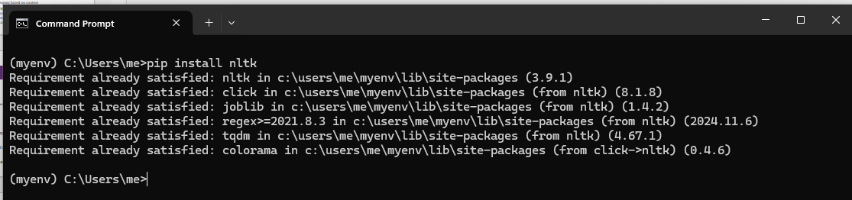
Introduction to NLTK (Natural Language Toolkit)
In this chapter we will use Python NLTK library to process text.
NLTK is a Python text processing library that was developed in 2001. It supports many essential NLP tasks like Tokenization, Stemming and Lemmatization, Sentiment Analysis and many other features.
We can install NLTK on our machine using the following command:
pip install nltk

Slide 9
Fundamental NLP Techniques

Slide 10
Tokenization
Tokenization: Breaking text into words, phrases, or other meaningful elements
Word tokenization: Splitting "I love NLP." into ["I", "love", "NLP", "."]
Subword tokenization: Breaking words into meaningful pieces (e.g., "playing" → ["play", "##ing"])
Character tokenization: Splitting text into individual characters

Slide 11

Tokenize text using NLTK package
from nltk.tokenize import word_tokenize
#punkt is a pretrained tokenization model used for splitting text into sentences and words.
nltk.download('punkt')
sentence = "Large language models are revolutionizing business applications."
tokens = word_tokenize(sentence)
print(tokens)
Output:
['Large', 'language', 'models', 'are', 'revolutionizing', 'business', 'applications', '.']
[nltk_data] Downloading package punkt to /home/me/nltk_data... [nltk_data] Package punkt is already up-to-date!
Open Colab and go to tokenization example

Slide 12
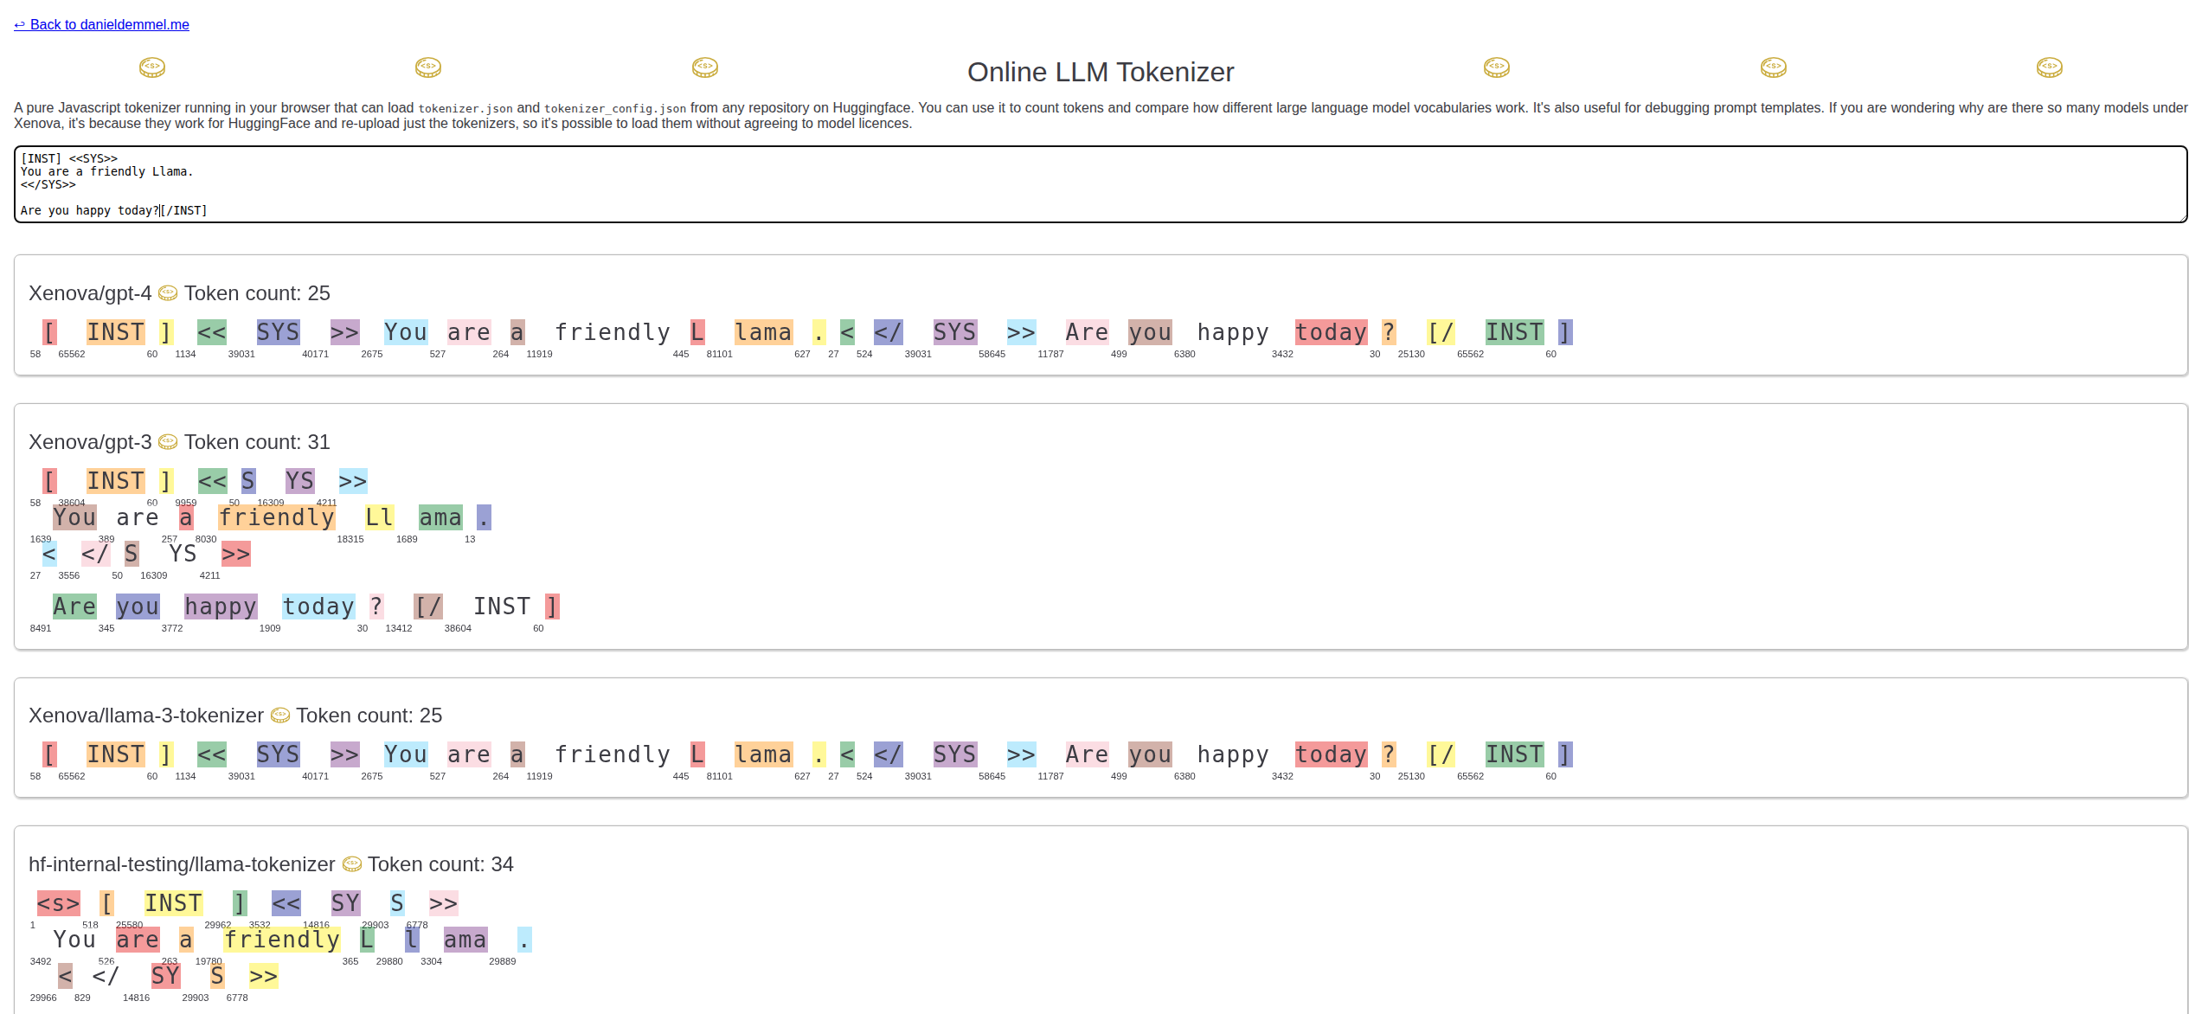
Test Tokenization using Online Tokenizers
https://www.danieldemmel.me/tokenizer.html
https://platform.openai.com/tokenizer
https://huggingface.co/spaces/Xenova/the-tokenizer-playground

Slide 13
Normalization
Normalization techniques convert text to a standard form to reduce variability.
The following code uses two techniques:
Converting text into lower case
Removing punctuation from text
# Lowercasing
normalized_tokens = [token.lower() for token in tokens]
print(normalized_tokens)
# Removing punctuation
import re
normalized_tokens = [re.sub(r'[^\w\s]', '', token.lower()) for token in tokens]
print(normalized_tokens)
The regular expression r'[^\w\s]' does the following:
r'...': This denotes a raw string in Python. Raw strings treat backslashes \ as literal characters, which is crucial for regular expressions.
[...]: This represents a character set.^: Inside a character set, ^ negates the set. It means "match any character not in this set.
"\w: This matches any word character, which includes alphanumeric characters (letters and digits) and the underscore (_).
\s: This matches any whitespace character, such as spaces, tabs, and newlines.
Therefore, r'[^\w\s]' matches any character that is not a word character or a whitespace character. In simpler terms, it matches any non-alphanumeric, non-underscore, and non-whitespace character. This effectively targets punctuation marks, symbols, and other special characters.
Output:
['large', 'language', 'models', 'are', 'revolutionizing', 'business', 'applications', '.']['large', 'language', 'models', 'are', 'revolutionizing', 'business', 'applications', '']
Open Colab and go to normalization example

Slide 14
Stopwords Removal
Stopwords removal process eliminates common words that add little meaning to text
Words like (is, are, at, on, the,…etc) can be removed from text to convert text to a standard form to reduce variability
#nltk.download('stopwords') #stopwords are common words that are often removed from text as they are not useful for analysis.
from nltk.corpus import stopwords
nltk.download('stopwords')
stop_words = set(stopwords.words('english'))
print("These words are removed from the text: ", stop_words)
Output:
These words are removed from the text: {'during', 'off', 'each', 'own', 'nor', "we've", "you'll", 'ourselves', 'between', 'same', 'such', 'against', 'but', "mustn't", "aren't", "wouldn’t”…etc
Open Colab and go to stopwords example

Slide 15
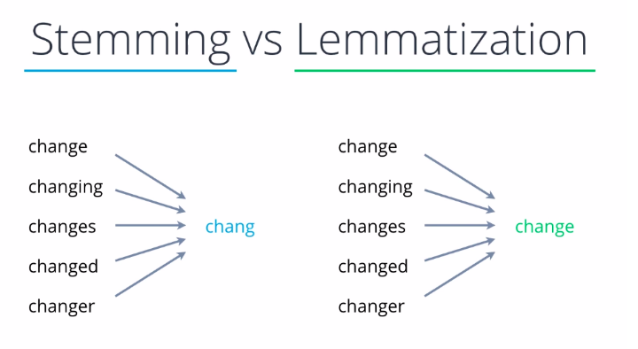
Stemming and Lemmatization
Stemming and lemmatization are text normalization techniques used in Natural Language Processing (NLP) to reduce words to their base or root forms.
They help in improving search engines, text mining, and language modeling by standardizing words with similar meanings.

Slide 16
Stemming
Definition: Stemming is a rule-based process that removes prefixes and suffixes (affixes) from a word to obtain its base form, often producing words that may not be actual words.
Method: Uses algorithms like Porter Stemmer and Snowball Stemmer.
Example:
"Running" → "Run"
"Studies" → "Studi"
"Better" → "Better" (Incorrectly unchanged)
"Caring" → "Car"
Limitations:
Often results in words that are not real words ("Studies" → "Studi").
Does not consider the actual meaning of words.

Slide 17
Lemmatization
Definition: Lemmatization is a dictionary-based approach that reduces words to their meaningful root form (lemma), considering the word's context and part of speech.
Method: Uses linguistic analysis and dictionaries (like WordNet Lemmatizer).
Example:
"Running" → "Run"
"Studies" → "Study"
"Better" → "Good" (Correct Lemma)
"Caring" → "Care"
Advantages:
More accurate than stemming.
Produces real words with proper meanings.
Use Cases:
Stemming is useful when speed is more important than accuracy (e.g., search engines).
Lemmatization is better for semantic analysis where meaning matters (e.g., AI chatbots, NLP applications).

Slide 18
Stemming Example
from nltk.stem import PorterStemmer
stemmer = PorterStemmer()
stemmed_tokens = [stemmer.stem(token) for token in filtered_tokens]
print(stemmed_tokens)
Lemmatizing Example
#nltk.download('wordnet')
from nltk.stem import WordNetLemmatizer
lemmatizer = WordNetLemmatizer()
lemmatized_tokens = [lemmatizer.lemmatize(token) for token in filtered_tokens]
print(lemmatized_tokens)
Open Colab and go to stemming example

Slide 19
Text Representation
Converting Text into Numbers

Slide 20
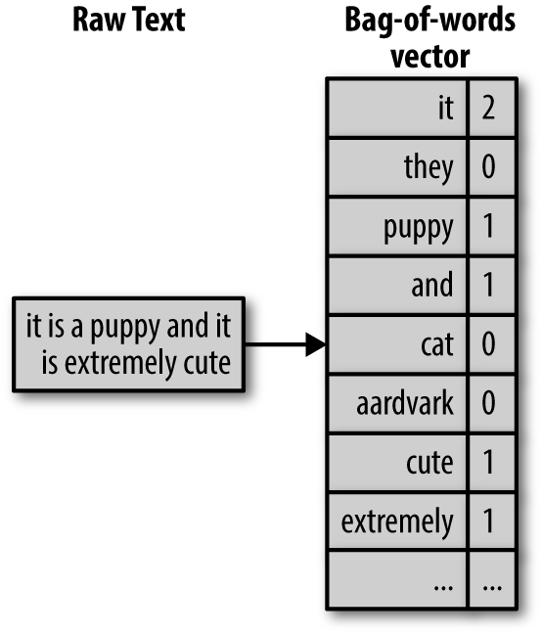
Bag of Words Method
Bag of Words is a fundamental technique in Natural Language Processing (NLP) that represents text as a collection of word frequencies, disregarding grammar and word order.
Core Concept
The Bag of Words model converts text documents into numerical feature vectors by:
Creating a vocabulary of all unique words in the corpus
For each document, counting how many times each vocabulary word appears
Simple Example:
Consider these two short sentences:
"I love natural language processing“
"Processing natural language is fun“
The vocabulary would be:
{"I", "love", "natural", "language", "processing", "is", "fun"}
Document 1 vector: [1, 1, 1, 1, 1, 0, 0]
Document 2 vector: [0, 0, 1, 1, 1, 1, 1]

Slide 21
BoW Basic Term Frequency Example
from sklearn.feature_extraction.text import CountVectorizer
corpus = [
"Large language models revolutionize business.",
"Business applications benefit from AI.",
"Language models learn from text data."
]
vectorizer = CountVectorizer()
X = vectorizer.fit_transform(corpus)
print(vectorizer.get_feature_names_out())
print(X.toarray())
 | ai | applications | benefit | business | data | from | language | large | learn | models | revolutionize | text
Vector 1 | 0 | 0 | 0 | 1 | 0 | 0 | 1 | 1 | 0 | 1 | 1 | 0
Vector 2 | 1 | 1 | 1 | 0 | 0 | 0 | 0 | 0 | 0 | 0 | 0 | 0
Vector 3 | 0 | 0 | 0 | 0 | 1 | 1 | 1 | 0 | 1 | 1
Open Colab and go to BoW example

Slide 22
BoW Method
Applications
BOW is commonly used in:
Text classification (spam detection, sentiment analysis)
Document clustering
Information retrieval
Topic modeling
Advantages
Simple to understand and implement
Computationally efficient
Effective for many basic NLP tasks
Limitations
Loses word order information
Ignores semantics and context
Creates high-dimensional, sparse vectors
Struggles with out-of-vocabulary words

Slide 23
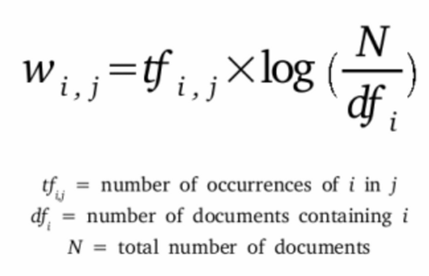
TF-IDF (Term Frequency-Inverse Document Frequency) Method
TF-IDF is a statistical measure that evaluates the importance of a word in a document relative to a collection of documents (corpus).
It improves upon the basic Bag of Words model by weighing terms based on how unique they are to a specific document.
Key Idea:
TF-IDF increases when a word appears frequently in a document but rarely across the corpus, making it a good indicator of relevance.

Slide 24
TF/IDF Example: Compute the TD/IDF for the words learn and data in sentence 1
We have two documents, document 1 and document 2
Document 1: AI models learn from data
Document 2: Data drives business decisions
1. Compute Term Frequency (TF) = Occurrences of word in document / Total words in document
Word | Sentence 1 (5 words) | Sentence 2 (4 words)
data | 1 / 5 = 0.2 | 1 / 4 = 0.25
learn | 1 / 5 = 0.2 | 0 / 4 = 0
Weights a word in a single document
2. Compute Inverse Document Frequency (IDF) = log(Count of all Documents / Count of Documents Containing Word)
Word | Count of Documents Containing Word | Count of all Documents | IDF
data | 2 | 2 | log(2/2) = 0
learn | 1 |  | log(2/1) ≈ 0.693
Weights a word across all documents (General Index)
3. Compute TF/IDF = TF x IDF
Word | Document 1 TF | IDF | TF-IDF
data | 0.2 | 0 | 0.2 × 0 = 0.0
learn | 0.2 | 0.693 | 0.2 × 0.693 ≈ 0.1386
data is more common across documents → TF-IDF = 0 (less informative)
learn is unique to document 1 → Higher TF-IDF (more informative)

Slide 25
TF-IDF (Term Frequency-Inverse Document Frequency)
from sklearn.feature_extraction.text import TfidfVectorizer
corpus = [
"Large language models revolutionize business.",
"Business applications benefit from AI.",
"Language models learn from text data."
]
tfidf_vectorizer = TfidfVectorizer()
# Transform the corpus into a document-term matrix
# Each row represents a document in the corpus
# Each column represents a unique word in the corpus
X_tfidf = tfidf_vectorizer.fit_transform(corpus)
df = pd.DataFrame(X_tfidf.toarray(), columns=tfidf_vectorizer.get_feature_names_out())
df
 | ai | applications | benefit | business | data | from | language | large | learn | models | revolutionize | text
Doc 1 | 0 | 0 | 0 | 0.3935 | 0 | 0 | 0.3935 | 0.5174 | 0 | 0.3935 | 0.5174 | 0
Doc 2 | 0.4905 | 0.4905 | 0.4905 | 0.373 | 0 | 0.373 | 0 | 0 | 0 | 0 | 0 | 0
Doc 3 | 0 | 0 | 0 | 0 | 0.4595 | 0.3495 | 0.3495 | 0 | 0.4595 | 0.3495 | 0 | 0.4595
Open Colab and go to TF-IDF example

Slide 26
Advantages of TF-IDF
Advantages
Reduces the impact of frequently occurring terms (like "the", "is", "of")
Highlights terms that are distinctive to specific documents
Relatively simple to implement and computationally efficient
Works well for sparse data
Limitations
Still ignores word order and semantics
Cannot capture relationships between related terms
May not work well for very short texts
Struggles with synonyms and polysemy
TF-IDF serves as a cornerstone technique in information retrieval and text mining, and remains widely used despite the emergence of more advanced embedding-based approaches.

Slide 27
Practical Example
Movie Review Sentiment Analysis Pipeline

Slide 28

Sentiment Analysis of Movie Reviews
This practical example will go through the entire text preprocessing pipeline and show how it contributes to a real-world NLP task.
Open the attached Jupyter Notebook to review the example.
We will use a simple corpus, the user reviews are registered as 0 or 1 → Like, Don’t Like.
We can also use the same text processing pipeline on IMDB dataset.
Open Colab and go to sentiment analysis example

Slide 29
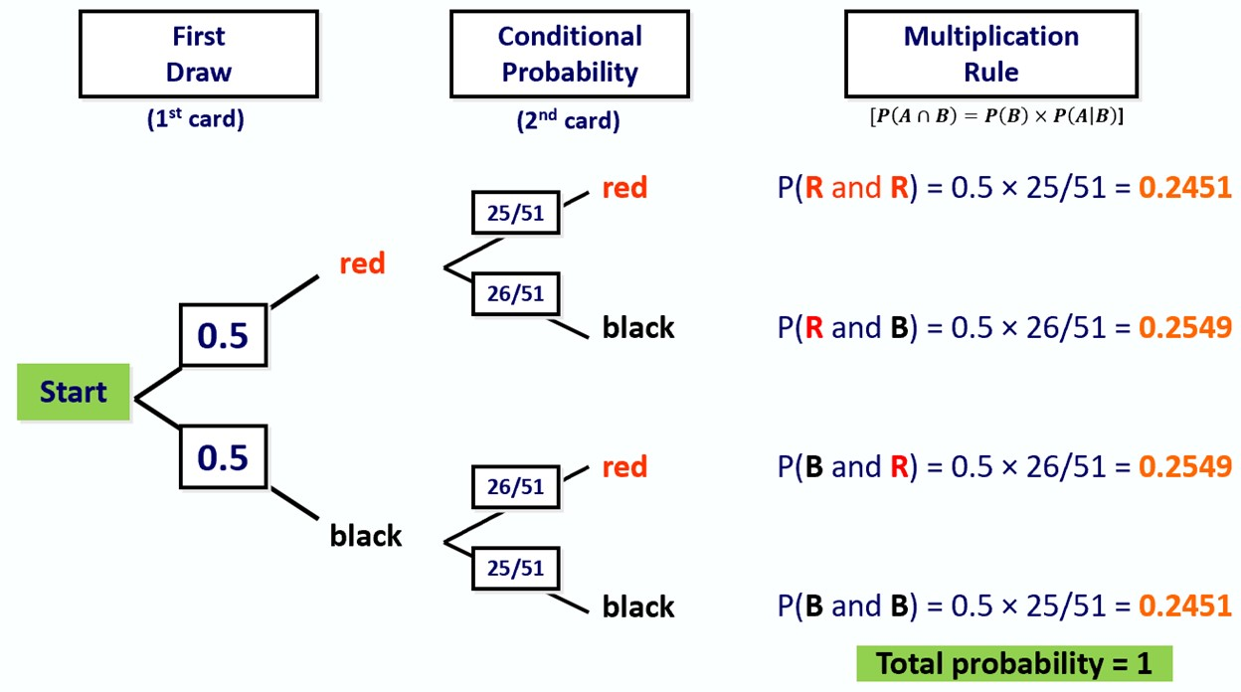
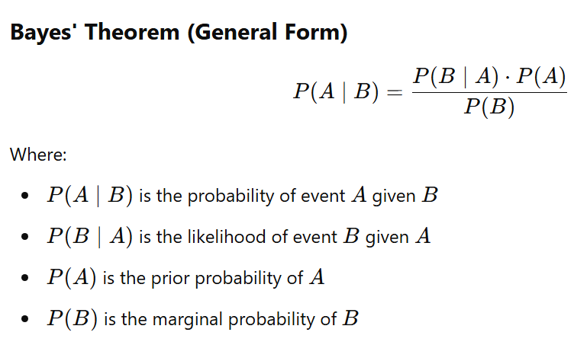
Naive Bayes Classifier for Sentiment Analysis
A probabilistic machine learning model based on Bayes’ Theorem
Assumes independence between features (words in our case)
Commonly used for text classification (e.g. spam detection, sentiment analysis)
P(black | black)
P(black and black)

Slide 30
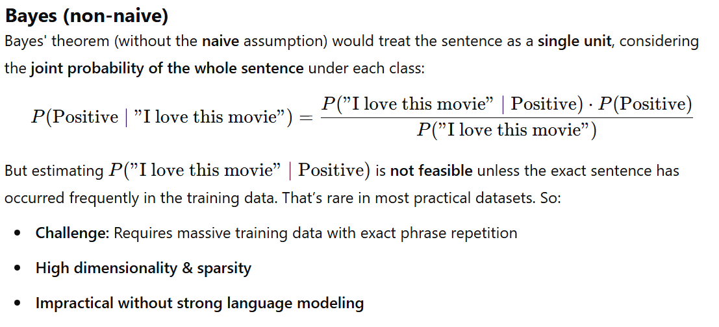
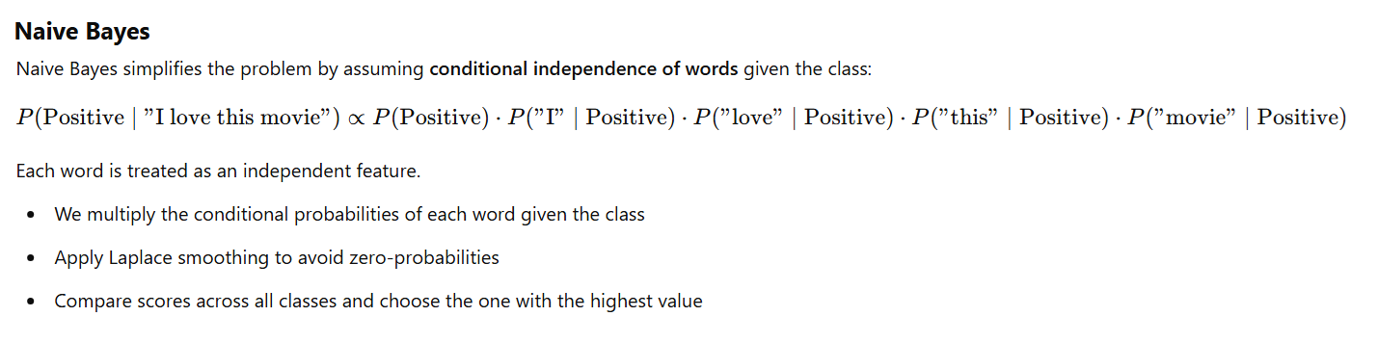
Bayes vs. Naïve Bayes

Slide 31
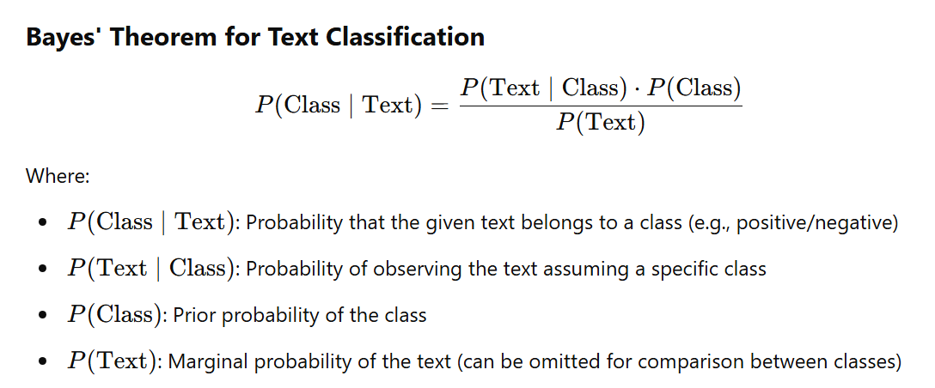
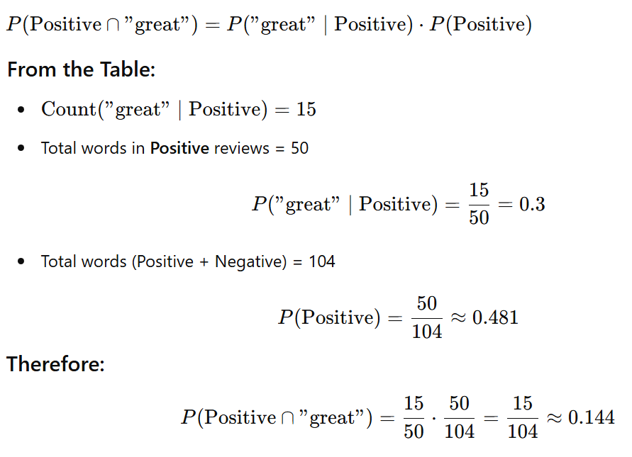
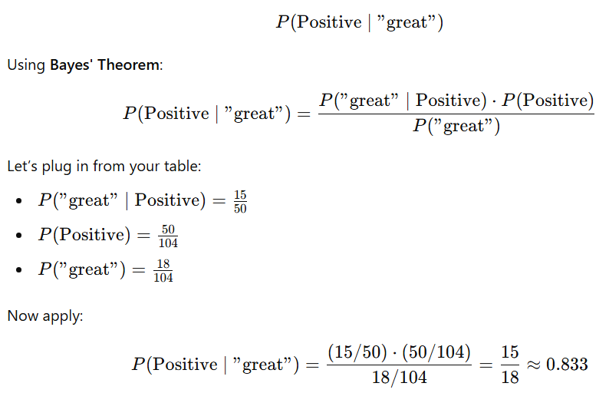
Naive Bayes Classifier for Sentiment Analysis
Word | Positive | Negative | Row Total
love | 20 | 2 | 22
great | 15 | 3 | 18
amazing | 12 | 1 | 13
boring | 1 | 14 | 15
terrible | 0 | 18 | 18
bad | 2 | 16 | 18
Total | 50 | 54 | 104

Slide 32
Problem Example
Task: Classify the sentiment of a sentence
Training Data:
1. I love this movie (Positive)
2. This film is amazing (Positive)
3. I hate this movie (Negative)
4. This film is terrible (Negative)
Classify: 'I love this film'

Slide 33
Step 1 – Vocabulary
Create a vocabulary of all words:
[I, love, this, movie, film, is, amazing, hate, terrible]

Slide 34
Step 2 – Word Frequencies
Count how often each word appears in each class:
Word | Positive | Negative
I | 1 | 1
love | 1 | 0
this | 2 | 2
movie | 1 | 1
film | 1 | 1
is | 1 | 1
amazing | 1 | 0
hate | 0 | 1
terrible | 0 | 1

Slide 35
Step 3 – Class Probabilities
We have 2 Positive and 2 Negative examples.
P(Positive) = 2/4 = 0.5
P(Negative) = 2/4 = 0.5

Slide 36
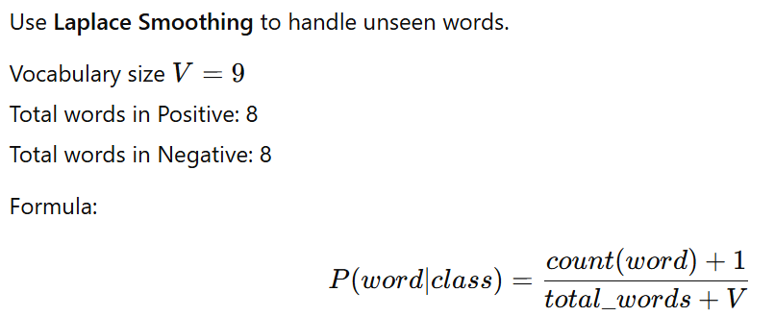
Step 4 – Laplace Smoothing

Slide 37
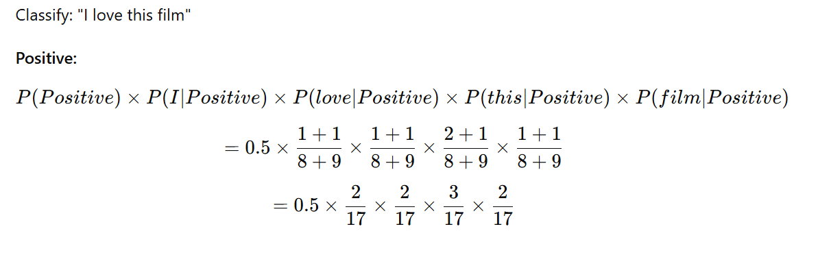
Step 5 – Calculate Probabilities (Positive)

Slide 38
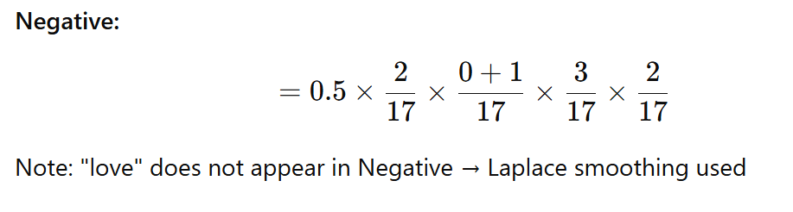
Step 5 – Calculate Probabilities (Negative)

Slide 39
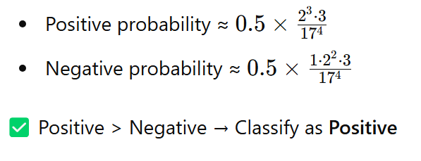
Final Calculation (Rough Comparison)

Slide 40
Language Models

Slide 41
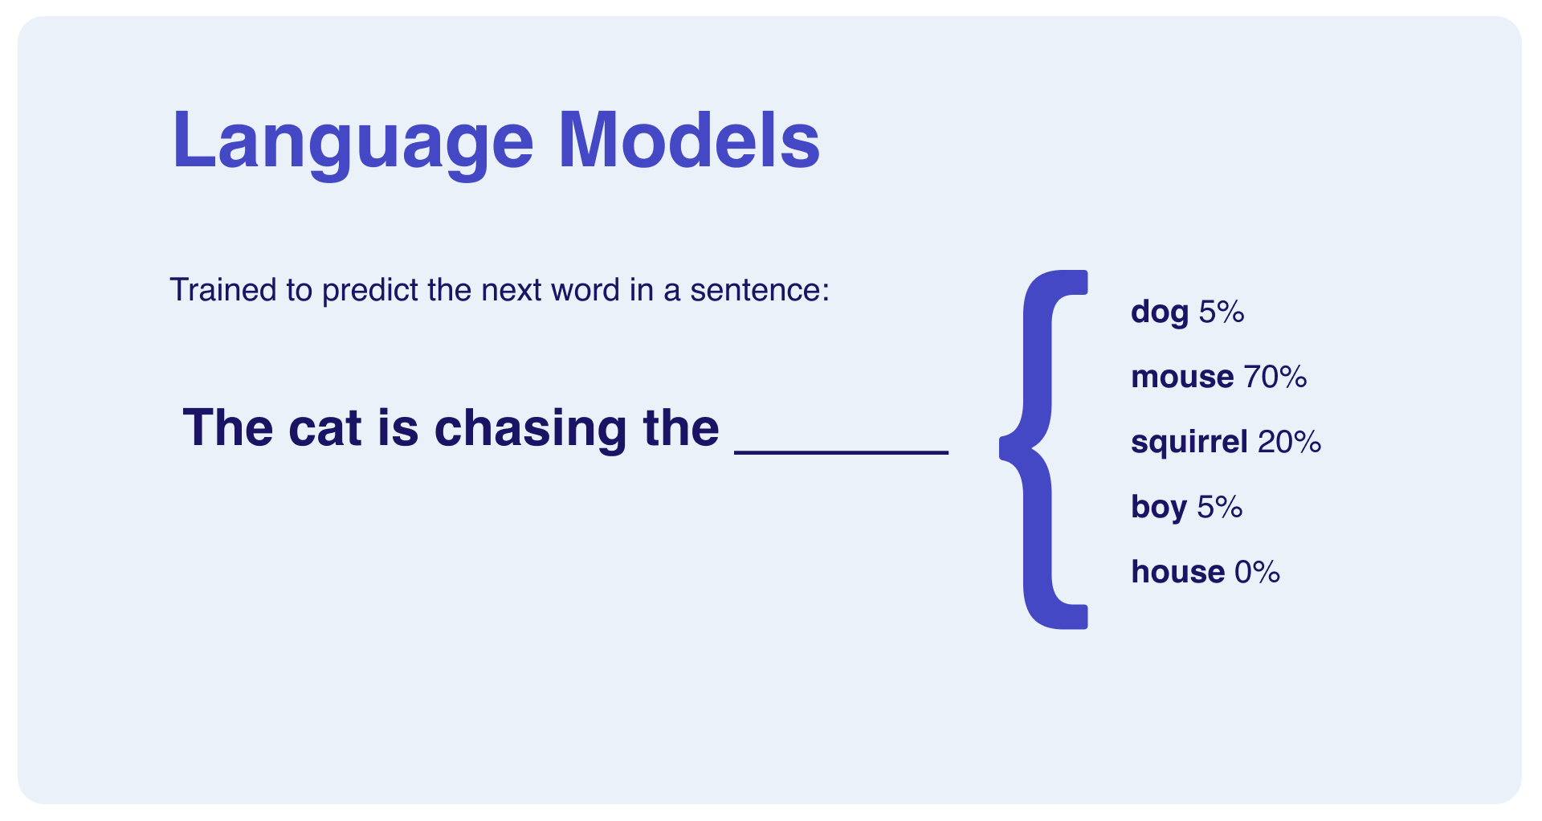
What is a Language Models?
Language models are statistical or neural models that capture the probability distribution of words or tokens in a language.
They predict the likelihood of a sequence of words occurring together, enabling machines to understand and generate human language.
Types of Language Models
1) Statistical Language Models
N-gram Models: Predict the next word based on the previous N-1 words
Unigram: P(word) - individual word probabilities
Bigram: P(word₂|word₁) - probability of word₂ given word₁
Trigram: P(word₃|word₁,word₂) - probability of word₃ given word₁ and word₂
2) Neural Language Models
RNN/LSTM-based: Process sequences by maintaining hidden states
Better at capturing long-range dependencies than n-grams
Examples: Early versions of Google Translate
Transformer-based: Use attention mechanisms to process entire sequences
BERT: Bidirectional, focuses on understanding context
GPT: Autoregressive, focuses on text generation
T5, RoBERTa, ELECTRA: Refinements of transformer architecture

Slide 42
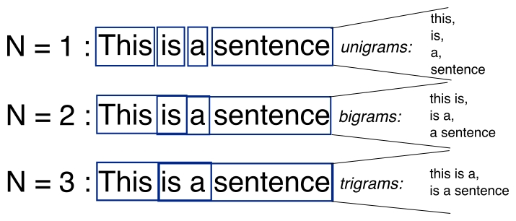
What are N-grams?
N-grams are a way to break down text into chunks of n words to understand language structure and context better.
Unigram (1-gram) = single words → "this", "is", "a", "sentence“
Bigram (2-gram) = pairs of consecutive words → "this is", "is a", "a sentence“
Trigram (3-gram) = triples of consecutive words → "this is a", "is a sentence"

Slide 43
Implementing Language Models using N-grams
This practical example will go through the process of creating an N-gram based language model.
Open the attached Jupyter Notebook to review the example.

Slide 44
Limitations of N-gram Models
Limited context: Only consider a fixed number of previous words
No long-range dependencies: Cannot capture relationships between distant words
No semantic understanding: Model captures statistical patterns but not meaning
Memory intensive: Storing all possible n-grams requires significant space
Data sparsity: Many valid word combinations don't appear in training data

Slide 45
Perplexity
Perplexity measures how confused a language model is when predicting text.
What It Means
Lower perplexity = Model is more confident and accurate
Higher perplexity = Model is more uncertain and confused
Simple Example
Imagine you're trying to predict the next word in: "I went to the _____"
A good model might assign high probability to words like "store," "park," "beach"
A confused model might spread probabilities evenly across thousands of words
Perplexity essentially counts how many reasonable options the model is considering. If the model has a perplexity of 10, it's like the model is equally confused between 10 possible words.
Real-World Comparison
If your phone keyboard suggests 3 very likely next words, it has low perplexity. If it suggests random unrelated words, it has high perplexity.
Why It Matters
Think of perplexity as a "confusion score" that helps researchers:
Compare different language models
Check if a model is improving during training
Identify when a model works better for certain types of text
The best language models today have much lower perplexity than older models, which is why they produce more natural-sounding text.

Slide 46
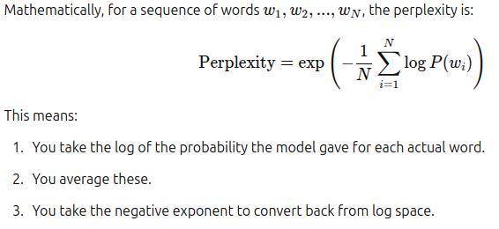
How Perplexity is Calculated

Slide 47
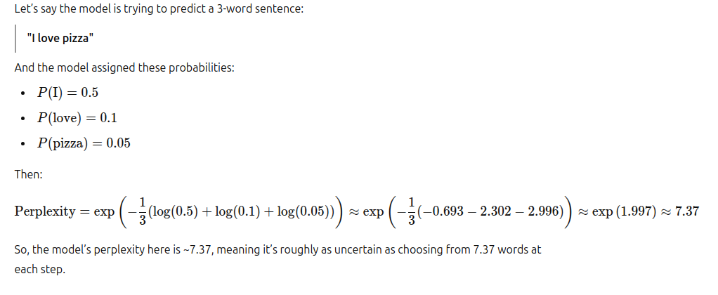
Quick Example

